Slide 1
Continuous Delivery of Microservices
Ken Mugrage - @kmugrage

Slide 2
Agenda
Introduction
Definitions
Anti-Patterns
Cultural Considerations
Technical Considerations
Testing
Deployment Patterns

Slide 3

Ambitious missions
Need disruptive thinking
Notes:
When we look back over our 20-year history and think about what has made - and continues to make - our clients so successful, we come up with two key themes that we think have made all the difference.
(1) They think big and go after hard problems with big payoffs. They want to lead - not just maintain status quo.
(2) They’re not afraid to disrupt their industry, and often to disrupt themselves internally. They go after big things, and they take a bold and completely different approach to getting there.
And they tell us that they choose as a partner because we also fit this description.

Slide 4
Definitions
Notes:
These are not new terms
They are often defined differently
These are the definitions I’ll be using for the remainder of this presentation.

Slide 5
Microservice
Small Autonomous services
that work together modeled
around a business domain
Independently Releasable
Newman, Sam (2015) Building Microservices O’Reilly
Notes:
The need for a service to be independently releasable is the golden rule of micro services. If your services must be deployed together, there’s not any reason to split them up in the first place.

Slide 6
Continuous integration
Continuous Integration is a software development practice where members of a team integrate their work frequently, usually each person integrates at least daily - leading to multiple integrations per day. Each integration is verified by an automated build (including test) to detect integration errors as quickly as possible.
http://martinfowler.com/articles/continuousIntegration.html Originally published 10 September 2000

Slide 7
devops
DevOps (a clipped compound of "development" and "operations") is a culture, movement or practice that emphasizes the collaboration and communication of both software developers and other information-technology (IT) professionals while automating the process of software delivery and infrastructure changes.[1][2] It aims at establishing a culture and environment where building, testing, and releasing software, can happen rapidly, frequently, and more reliably.
https://en.wikipedia.org/wiki/DevOps
http://www.jedi.be/blog/2010/02/12/what-is-this-devops-thing-anyway/
Notes:
http://www.jedi.be/blog/2010/02/12/what-is-this-devops-thing-anyway/

Slide 8
Continuous delivery
Continuous Delivery is a software development discipline where you build software in such a way that the software can be released to production at any time.
Humble, Jez – Farley, David (2010) Continuous Delivery Addison Wesley
Notes:
While people have certainly been deploying to production automatically for quite a while the term continuous delivery was quite in this 2010 book by Jez Humble and David Farley (both ThoughtWorkers at the time)

Slide 9
Continuous delivery
Delivery Team
Commit
Build and Unit Tests
Automated Acceptance
User Acceptance
Deploy
http://continuousdelivery.com/2010/02/continuous-delivery/

Slide 10
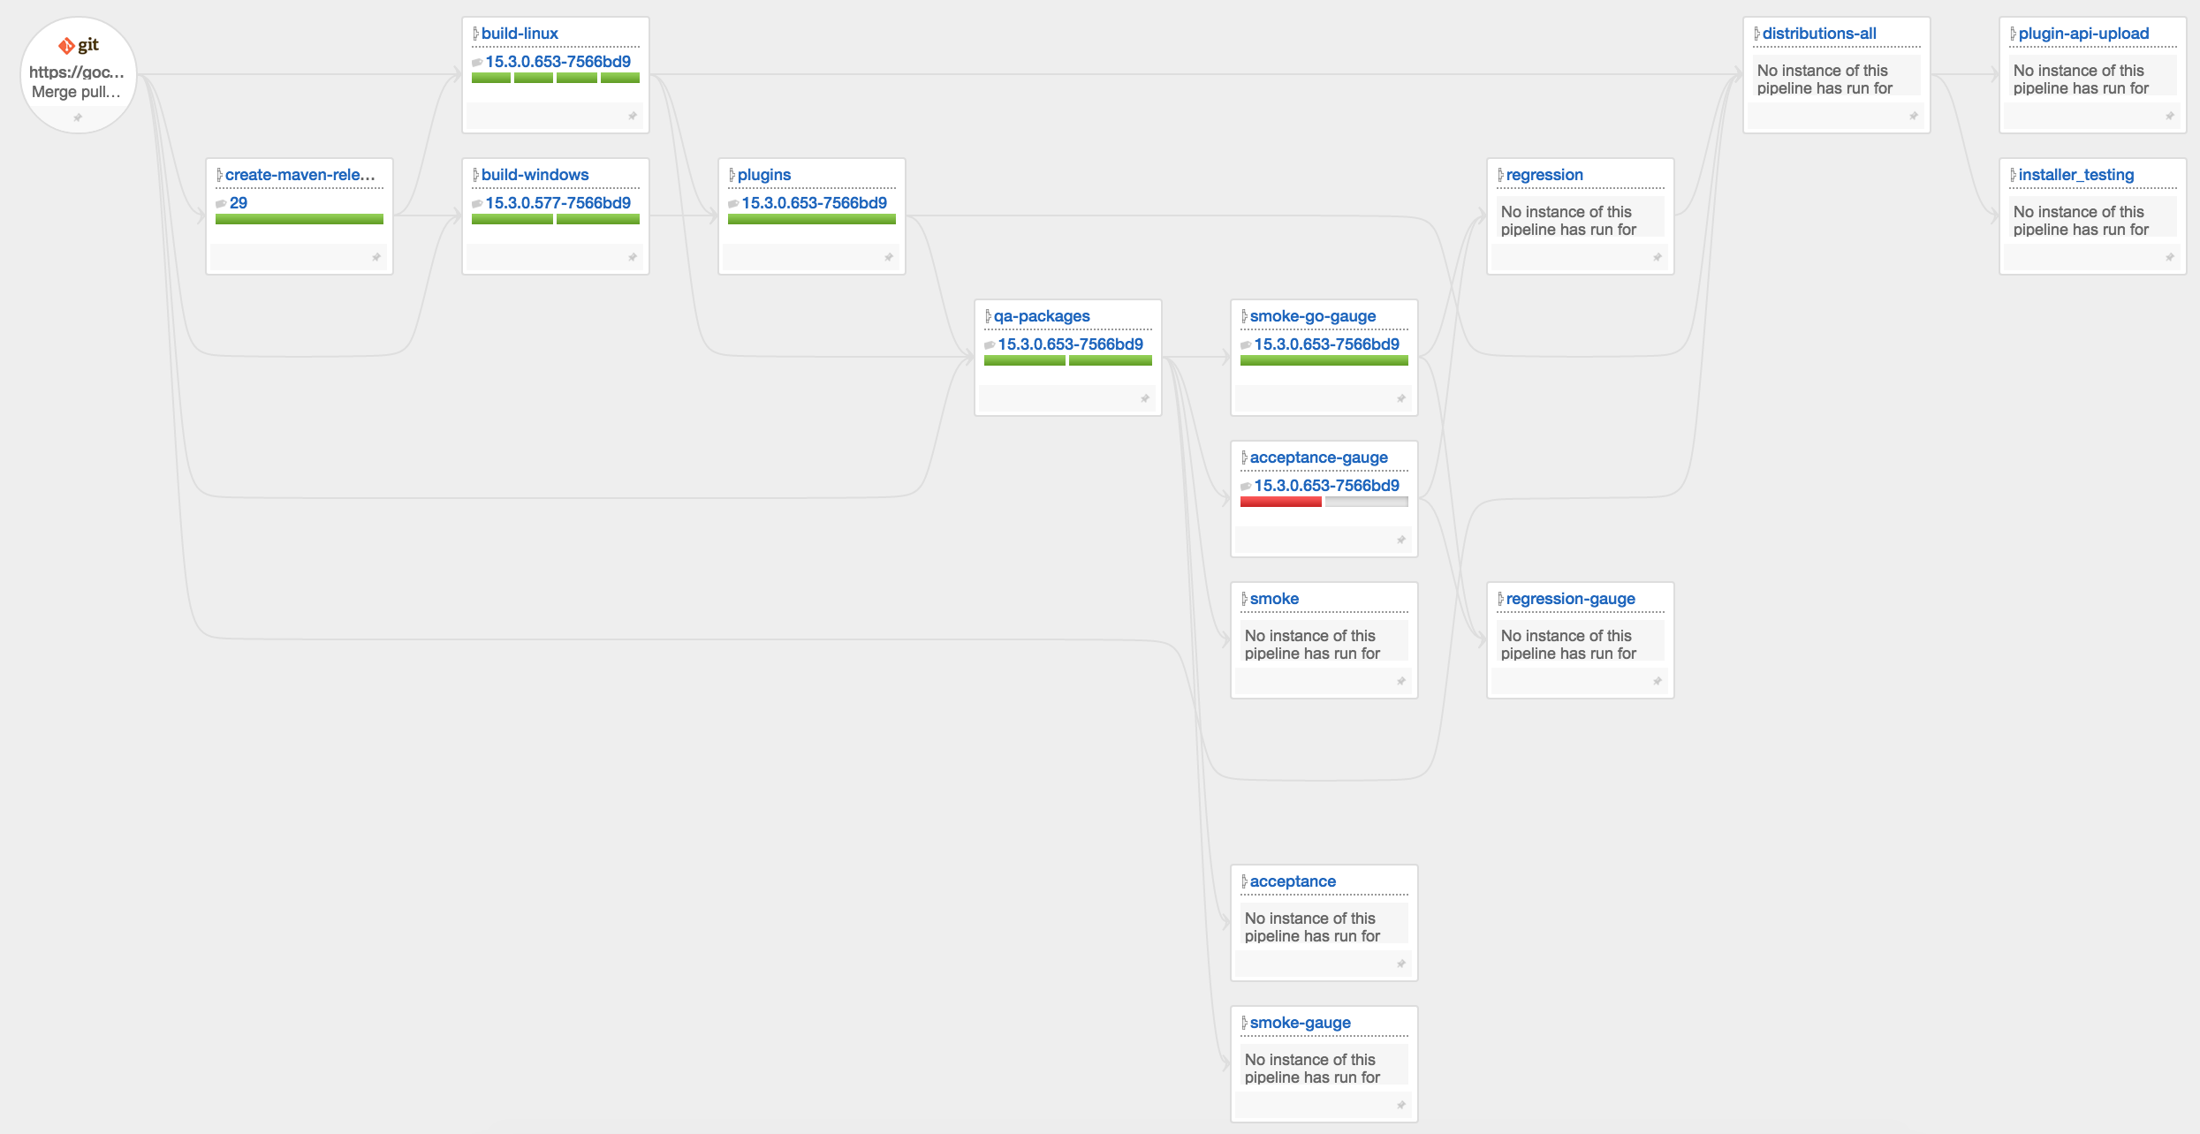
What CD looks like

Slide 11
Continuous delivery
You’re doing Continuous Delivery when:
Your software is deployable throughout its lifecycle
Your team prioritizes keeping the software deployable over working on new features
Anybody can get fast, automated feedback on the production readiness of their systems and time somebody makes a change to them
You can perform push-button deployments of any version of the software to any environment on demand
Notes:
These indicators were developed by the continuous delivery working group at thoughtworks

Slide 12
Continuous delivery anti-patterns

Slide 13
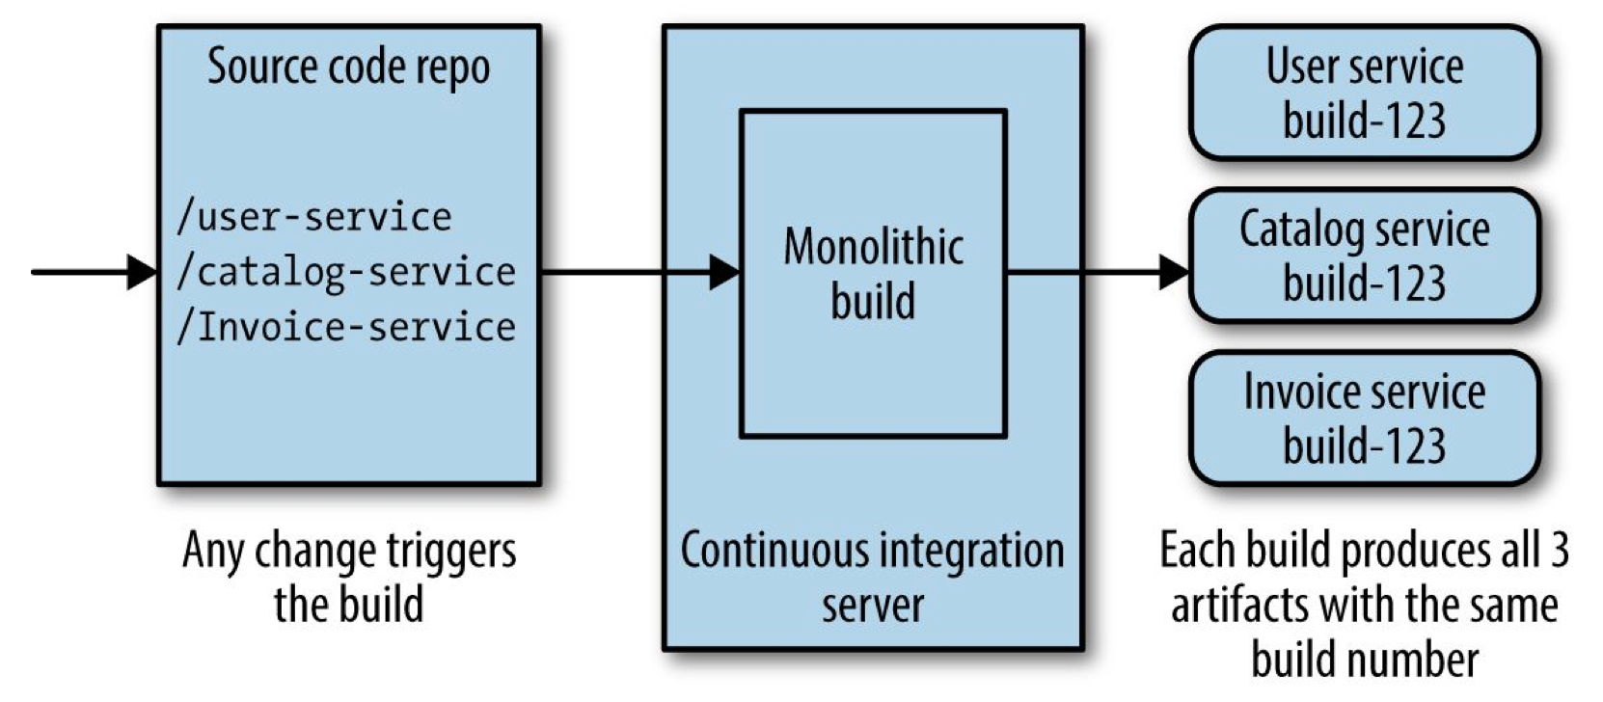
The really complicated monolith
Newman, Sam (2015) Building Microservices O’Reilly
Notes:
Unfortunately, this is very common. All we’ve done here is create a monolith that will be harder to troubleshoot when something goes wrong.

Slide 14
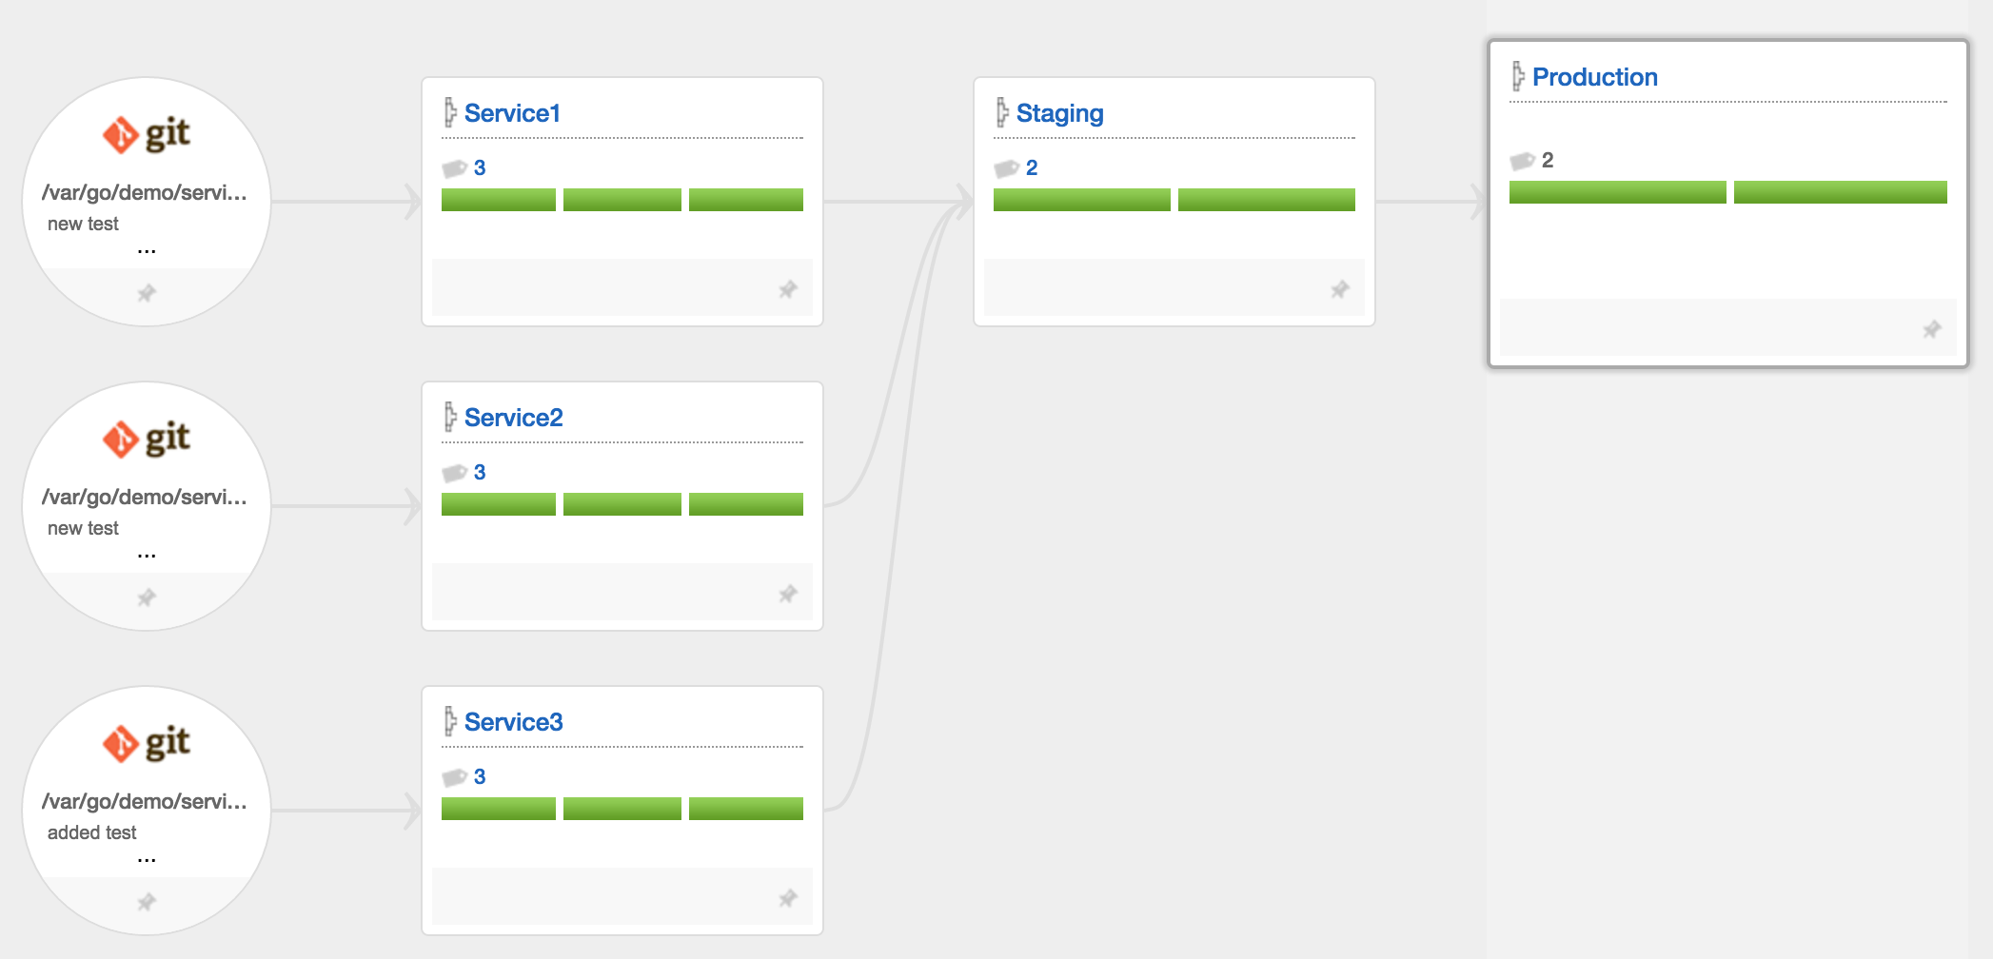
Deploying everything at once
Notes:
This anti-pattern has three teams that are working with reasonably good continuous integration practices. The builds from these teams are then grabbed by somebody and deployed all at the same time. What we have done here is introduce the complexity of a micro service-based architecture, without any of the advantages.

Slide 15
Requiring specific versions
Service 1
Service 2
Service 3

Slide 16
Requiring specific versions
Service 1
Service 2
Service 3

Slide 17
Cultural considerations
(Spoiler: This is the hardest part)

Slide 18
Conway’s law
Any organization that designs a system (defined broadly) will produce a design whose structure is a copy of the organization's communication structure.
http://www.melconway.com/Home/Conways_Law.html

Slide 19
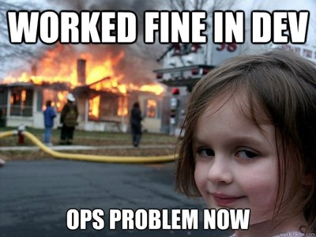
devops

Slide 20
Technical considerations

Slide 21
Architecture
Loose coupling
A change to one service should not require a change to another
High cohesion
Related behavior sits together, unrelated behavior sits elsewhere
Notes:
The ability to do continuous delivery within micro service architecture is mostly dependent on how you architect those services
A big cause of tight coupling is the integration style – see the book for examples
High cohesion - Making changes in lots of places is slower, and deploying multiple services is risky

Slide 22
integration
Avoid breaking changes
Keep your APIs technology agnostic
Make your service simple for consumers
Hide internal implementation detail

Slide 23
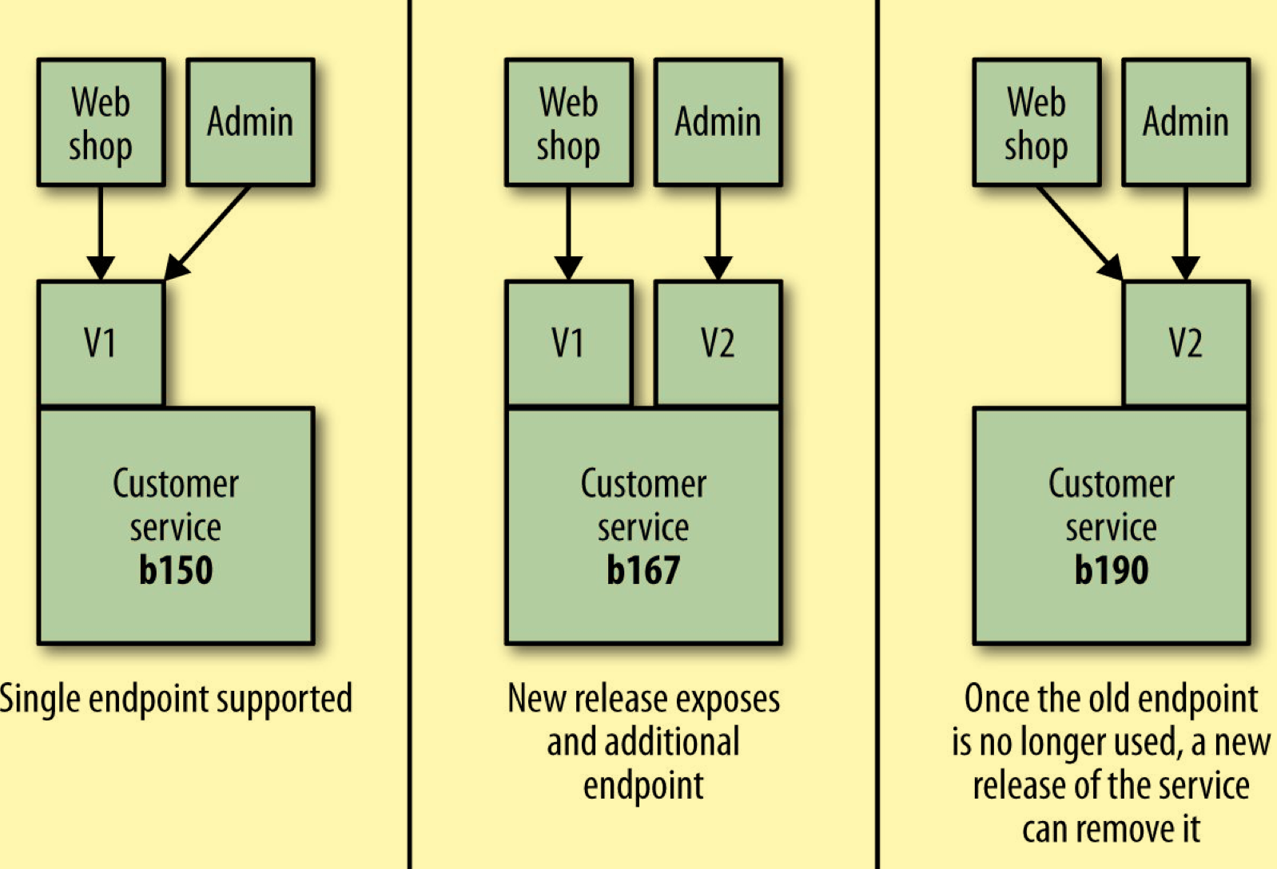
If you really need a breaking change
We really want to avoid forcing consumers to upgrade in lock step
Newman, Sam (2015) Building Microservices O’Reilly

Slide 24
Getting integration right is the single most important aspect of the technology associated with microservices in my opinion.
Newman, Sam (2015-02-02). Building Microservices.

Slide 25
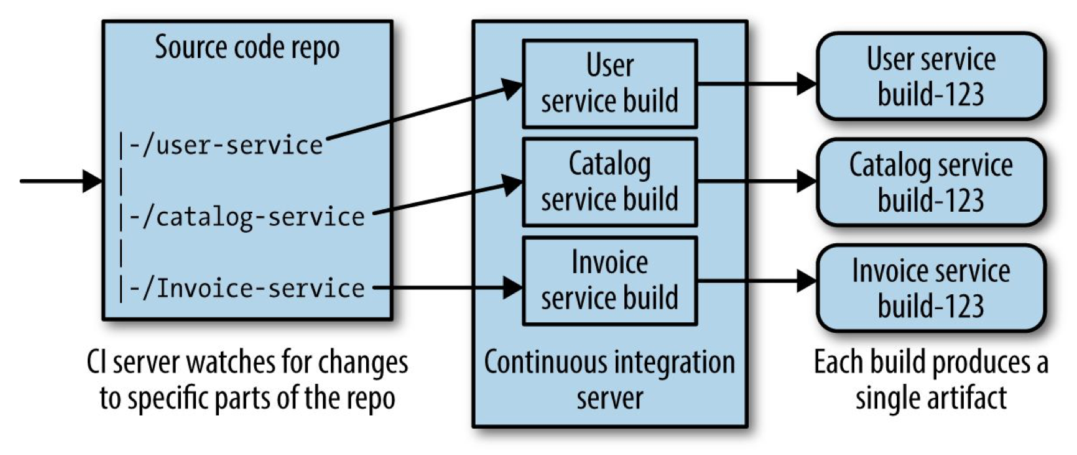
Continuous Integration
Newman, Sam (2015) Building Microservices O’Reilly

Slide 26
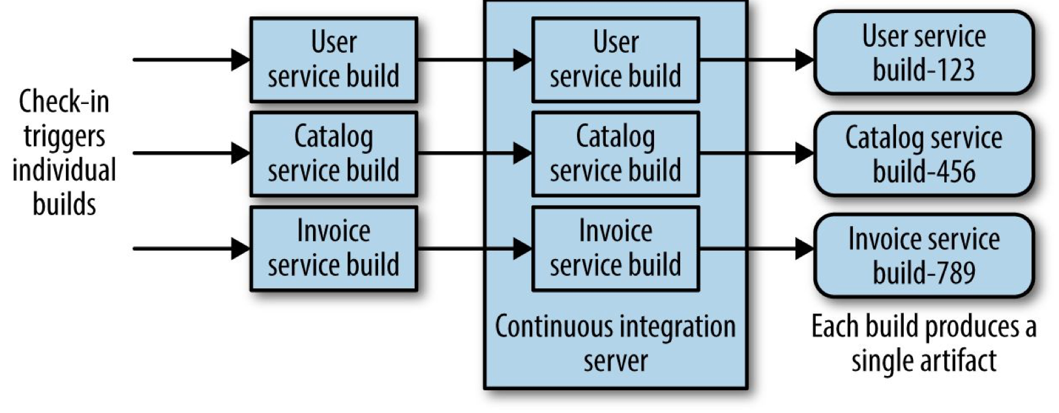
Continuous Integration
Newman, Sam (2015) Building Microservices O’Reilly

Slide 27
Build considerations
A thing gets built exactly once
One host / one service
Consider OS specific deployment packages
Consider building the entire host
Notes:
Can’t have a presentation with mentioning Docker

Slide 28
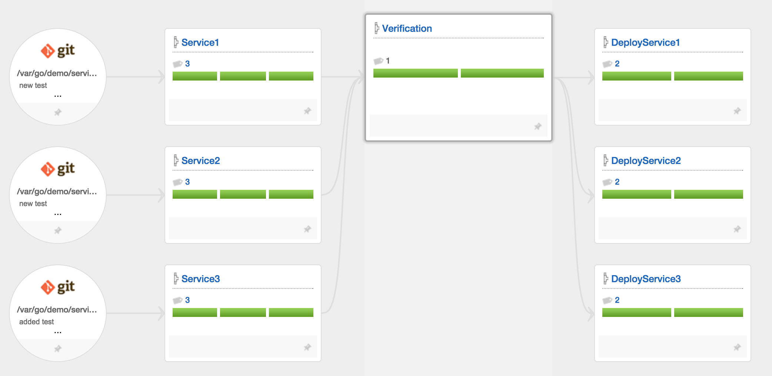
Continuous delivery
Use fan in / fan out to build confidence

Slide 29
Continuous delivery – the goal

Slide 30
Testing

Slide 31
TestinG
If you’re doing a lot of manual testing, stop here and address that first
Unit tests
Service tests
A smarter stub service - http://www.mbtest.org/
Notes:
Unit testing should actually be easier since these are small applications. These are tests which typically test a single function or method call
The reason we want to test a single service by itself is to improve the isolation of the test to make finding and fixing problems faster. To achieve this isolation, we need to stub out all external collaborators so only the service itself is in scope. Our service test suite needs to launch stub services for any downstream collaborators (or ensure they are running), and configure the service under test to connect to the stub services. We then need to configure the stubs to send responses back to mimic the real-world services. For example, we might configure the stub for the loyalty points bank to return known points balances for certain

Slide 32
Nonfunctional testing

Slide 33
Cross functional testing
Performance
Security
Individual services have individual expectations

Slide 34
Deployment patterns

Slide 35
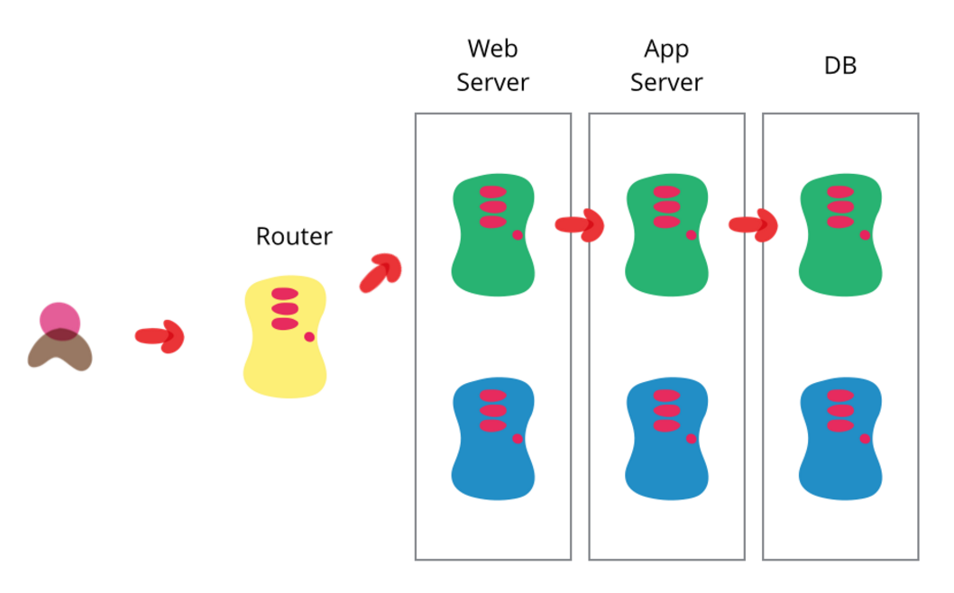
Blue / Green deployment
http://martinfowler.com/bliki/BlueGreenDeployment.html

Slide 36
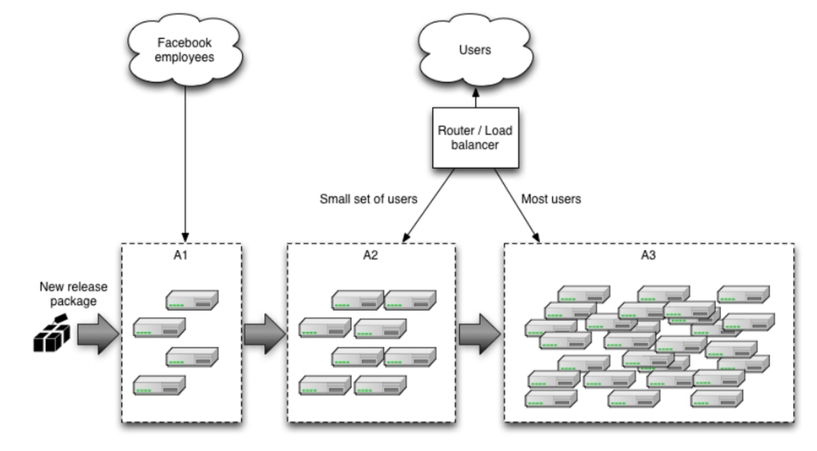
Canary release

Slide 37

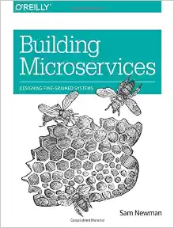
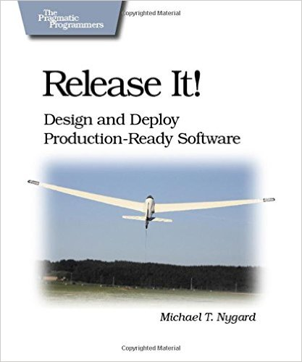
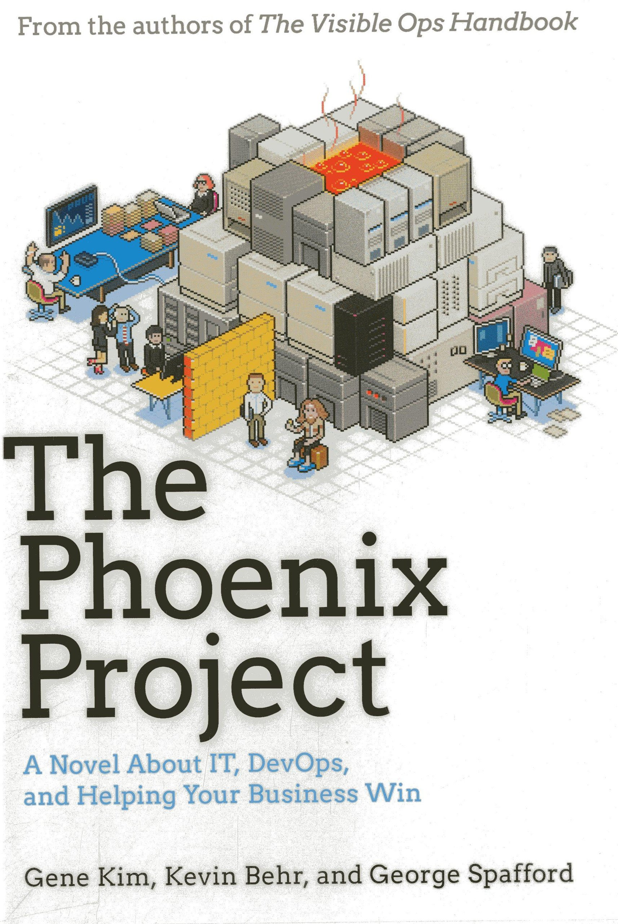
Further reading

Slide 38
Summary
The ability to deploy independently is vital
The culture is the hardest part
One service / one host helps find issues
Purpose built tools help the journey

Slide 39
THANK YOU
http://www.thoughtworks.com/go
http://www.go.cd/
@goforcd
@kmugrage

